Slide 1
INDUSTRIAL SEMINAR
Team 5
BY
Rashad Mohammed - RA2111026040027
S. Vijay Krishna Sundaran - RA2111026040042
Amivarshaa Balaji - RA2111026040049

Slide 2
DATA DESCRIPTION
The DARWIN dataset contains handwriting data which is composed of 25 handwriting tasks. The dataset was specifically designed for the early detection of Alzheimer’s disease (AD). The dataset includes data from 174 participants (89 AD patients and 85 healthy people).
The file “DARWIN.csv” contains the acquired data. The file consists of one row for each participant plus an additional header row. The first row is the header row, the next 89 rows collect patients data, whereas the remaining 84 rows collect information from healthy people.
The file consists of 452 columns. The first column shows participants' identifiers, whereas the last column shows the class to which each participant belongs. This value can be equal to 'P' (Patient) or 'H' (Healthy).
The remaining columns report the features extracted from a specific task. The tasks performed are 25, and for each task 18 features have been extracted. The column will be identified by the name of the features followed by a numeric identifier representing the task the feature is extracted. E.g., the column with the header "total_time8" collects the values for the "total time" feature extracted.

Slide 3

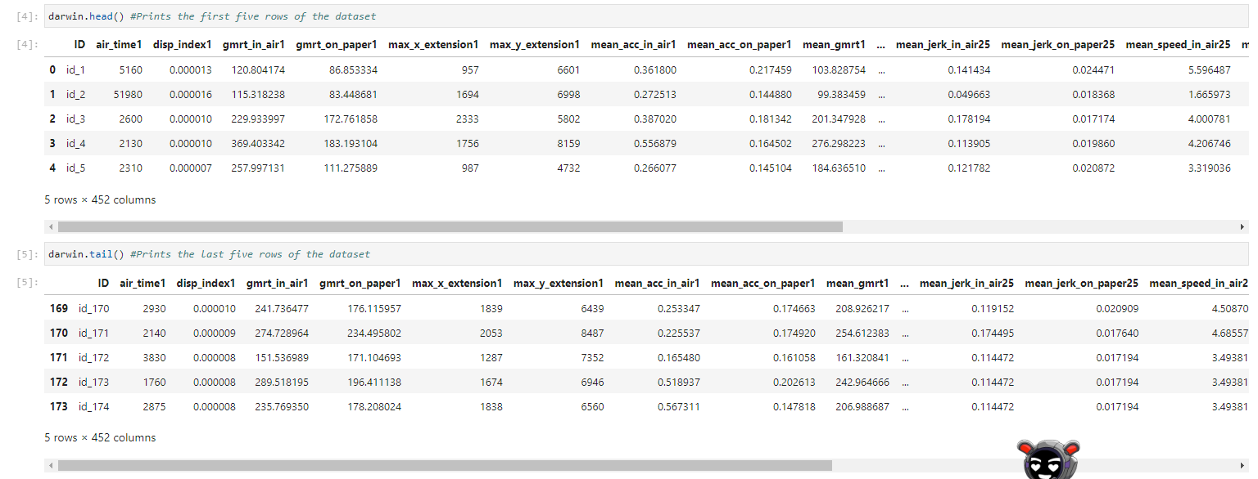
DATA OVERVIEW

Slide 4
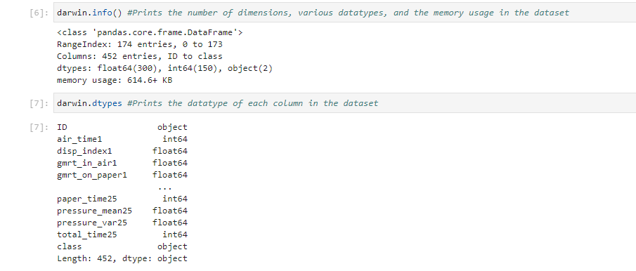

Slide 5
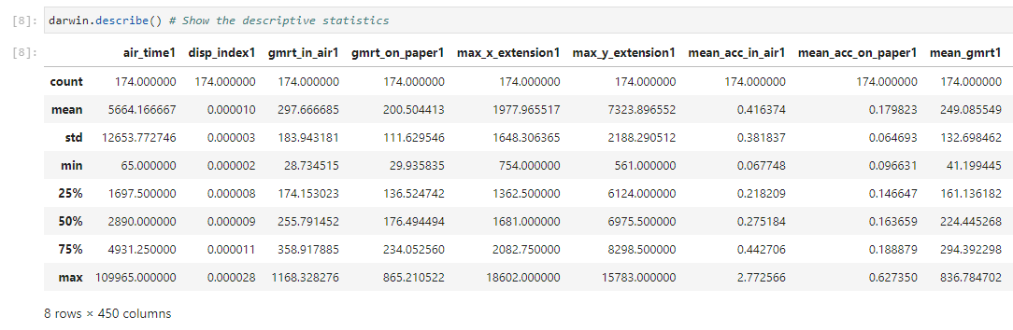
SUMMARY STATISTICS

Slide 6
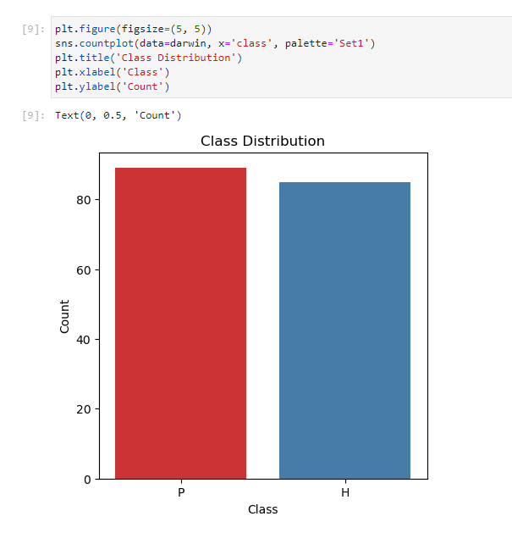
CLASS DISTRIBUTION

Slide 7
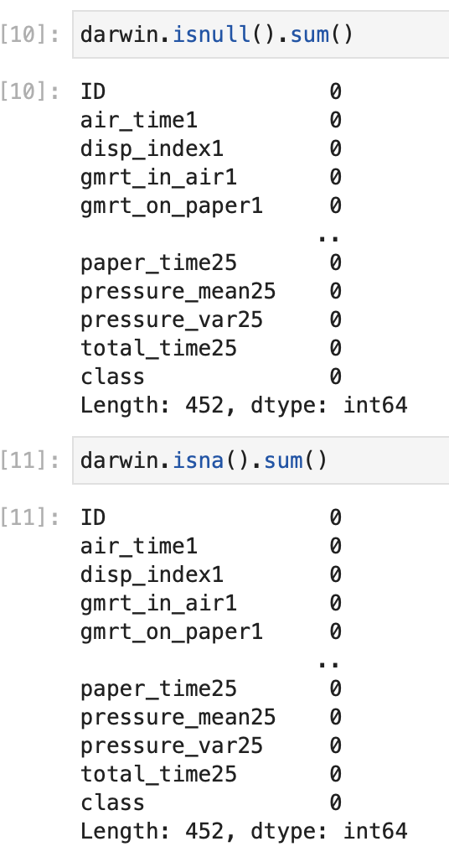
Error Handling
Objective:
Detect Mistakes: Identify errors during execution.
Notify and Report: Alert program/user for action.
Handle Gracefully: Prevent crashes with a controlled response.
Benefits:
Enhanced Reliability: Improves program robustness.
Maintains Stability: Ensures smooth functioning.
Debugging Aid: Facilitates easier debugging.
User-Friendly: Enhances user experience.

Slide 8
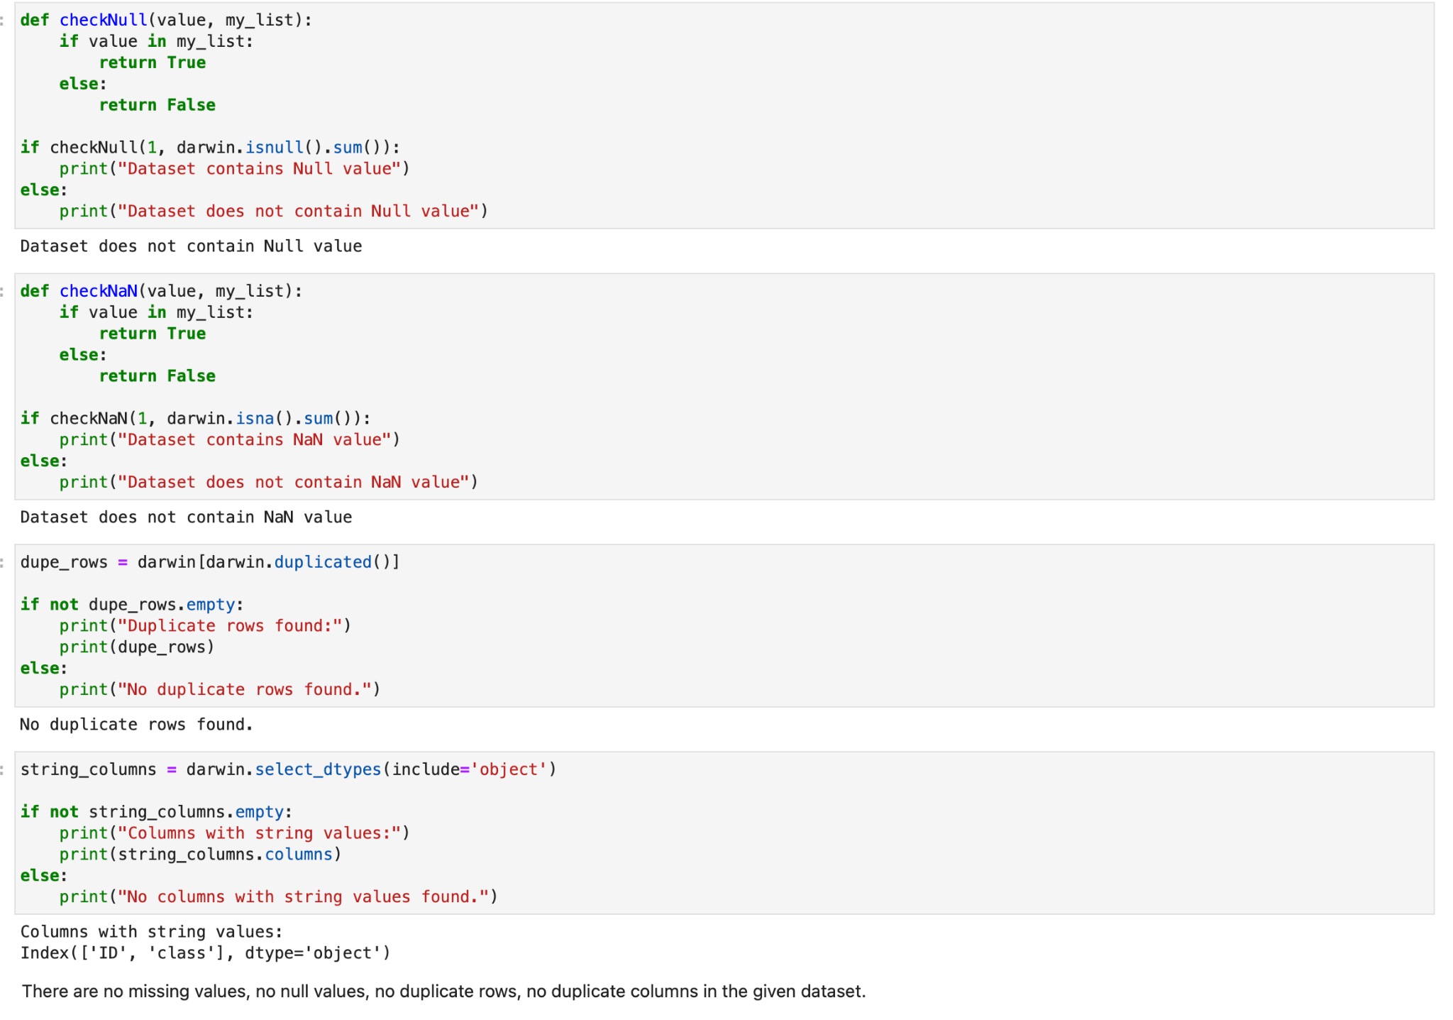

Slide 9
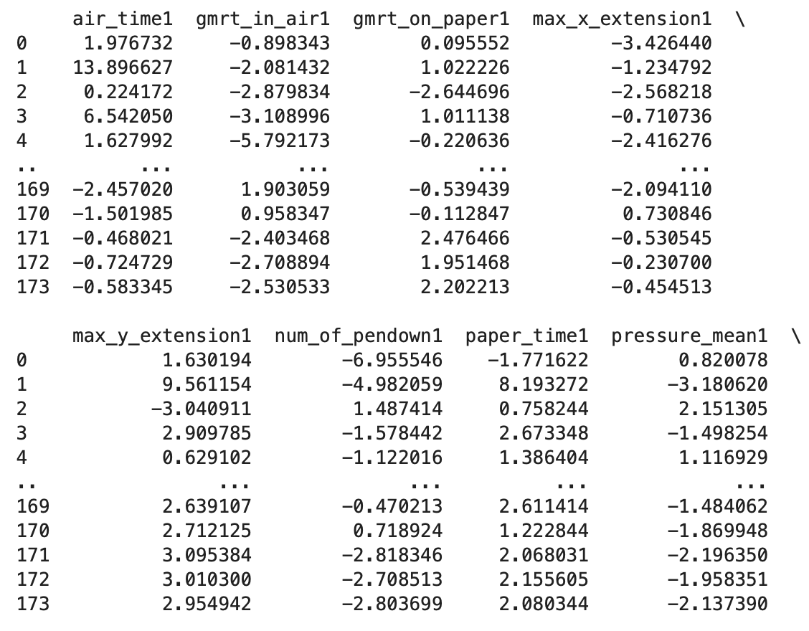
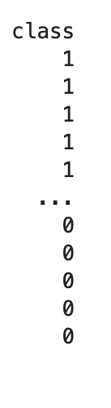


Feature Engineering
Reduce High-dimensionality Low Variance Filtering:
PCA-Principal Component Analysis
…
High Correlation Filtering:

Slide 10
MODELING
XGBoost Model
CatBoostClassifier Model

Slide 11
Preprocessing
Objective:
Prepare the dataset for model training by encoding the target variable and splitting the data into training and testing sets.
Benefits:
Encoded target variable ensures compatibility with machine learning algorithms.
Splitting the dataset enables unbiased evaluation and validation of the model.

Slide 12
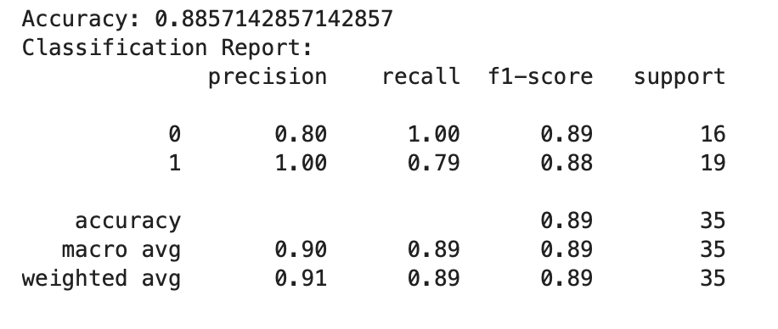
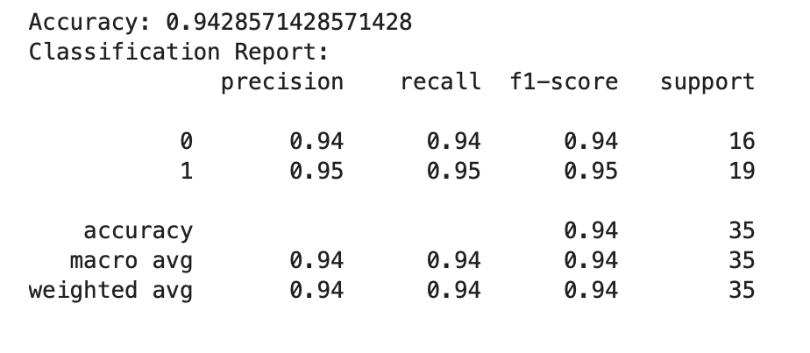
Model Comparison - XGBoost V/s CatBoostClassifier
XGBoost Model:
Accuracy: 88.57%
Classification Report:
CatBoostClassifier:
Accuracy: 94.28%
Classification Report:
Conclusion ♦ Both models perform well, with CatBoost achieving a slightly higher accuracy compared to XGBoost.
♦ CatBoost shows excellent performance in classifying both 'Patient' and 'Healthy' classes.

